Slide 1
18-349: Introduction to Embedded Real-Time Systems Lecture 3: ARM ASM
Anthony Rowe
Electrical and Computer Engineering
Carnegie Mellon University

Slide 2
Lecture Overview
Exceptions Overview (Review)
Pipelining
ARM ASM Introduction
Move operations
Arithmetic operations
Logical operations
Comparison operations
Multiply operations
Conditionals

Slide 3
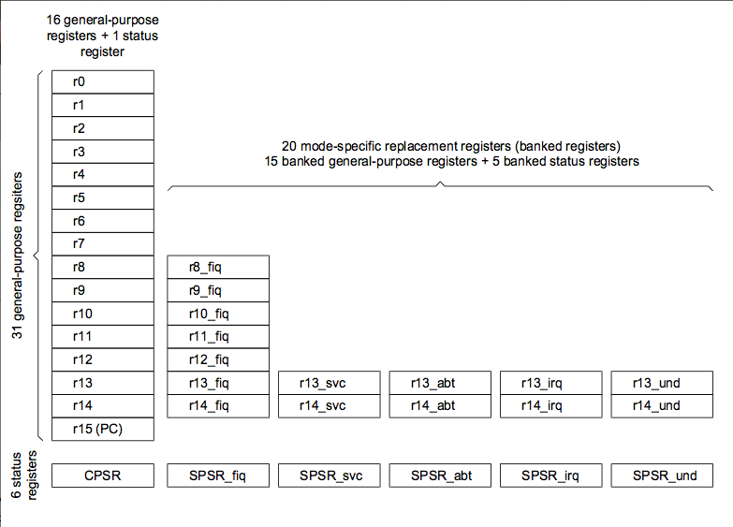
Reminder: ARM Register Set

Slide 4
Control Flow
Processors do only one thing:
From startup to shutdown, a CPU simply reads and executes (interprets) a sequence of instructions, one at a time
This sequence is the CPU’s control flow (or flow of control)
Physical control flow
<startup>
inst₁
inst₂
inst₃
…
inst_{n}
<shutdown>
Time

Slide 5
Exceptions
An exception is a transfer of control to supervisory mode in response to some event (i.e., change in processor state)
Examples:
div by 0, arithmetic overflow, page fault, I/O request completes, Ctrl-C
User Process
OS
event
I_current
exception
I_next
exception processing
by exception handler
return to I_current
return to I_next
abort

Slide 6
The Vector Table
Reserved area of 32 bytes at the end of the memory map
Placed at address 0x0
One word of space for each exception type
Contains a Branch or Load pc instruction for the exception handler
Notice that the FIQ exception-handler is at the end of the vector table – why?
0x1C
FIQ
0x18
IRQ
0x14
(Reserved)
0x10
Data Abort
0x0C
Prefetch Abort
0x08
Software Interrupt
0x04
Undefined Instruction
0x00
Reset
Notes:
FIQ at end so that you can put code there without needing to branch!

Slide 7
The Vector Table
Exception
numbers
code for
exception handler 0
Each type of event has a unique exception number k
k = index into exception table (a.k.a. interrupt vector)
Handler k is called each time exception k occurs
Exception
Table
code for
exception handler 1
0
1
code for
exception handler 2
2
...
n-1
...
code for
Fastest exception handler n-1

Slide 8
Exception Handling
When an exception occurs, the ARM:
Copies cpsr into spsr_<mode>
Sets appropriate cpsr bits
Change to ARM state
Change to exception mode
Disable interrupts (if appropriate)
Stores the return address in lr_<mode>
Sets pc to vector address
To return, exception handler (the code you write) needs to:
Restore cpsr from spsr_<mode>
Restore pc from lr_<mode>
Handle the general-purpose (gp) registers appropriately
0x1C
FIQ
0x18
IRQ
0x14
(Reserved)
0x10
Data Abort
0x0C
Prefetch Abort
0x08
Software Interrupt
0x04
Undefined Instruction
0x00
Reset

Slide 9
Example: User to Supervisor
Your program is initially in User mode
When the processor executes the SWI instruction, the ARM processor does the following for you automatically:
Copies cpsr into spsr_svc
Sets appropriate cpsr mode bits to 10011 (svc mode)
Disables IRQs
Stores return address (pc – 4) in lr_svc
Sets pc to vector address 0x08
To return, exception handler (the code you have to write) needs to:
Restore cpsr from spsr_svc (cpsr now has mode bits 10000 = usr mode)
Restore pc from lr_svc
In Supervisor mode, a single instruction can be used to cause the SPSR for the current mode to be copied into CPSR while copying lr into pc
MOVS pc, lr

Slide 10
Peak at an Exception Handler
; ARM processor has already done its part
S_Handler
STMFD sp!, {r0­r12, lr} ; store user's gp registers and lr_svc
MOV r1, sp ; ignore for now
LDR r0, [lr, #­4] ; ignore for now
BIC r0,r0,#0xff000000 ; ignore for now
BL C_SWI_handler ; ignore for now
LDMFD sp!, {r0­r12, lr} ; unstack user's registers and lr_svc
MOVS pc, lr ; return from handler

Slide 11
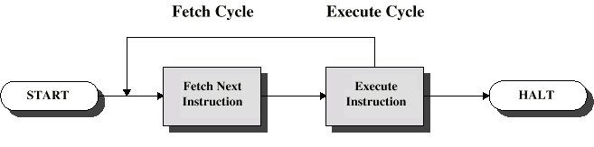
Instruction Cycle
Two Steps:
Fetch
Execute

Slide 12
The Fetch Cycle
Program Counter (PC)
Holds address of next instruction that the processor should fetch
So, what happens?
Processor fetches instruction from the memory location that the PC points to
Processor then increments PC
Unless specified otherwise
Sometimes, an offset added depending on processor architecture
Instruction loaded into Instruction Register (IR)
Processor interprets instruction and performs required actions

Slide 13
The Execute Cycle
Processor-memory interactions
Data transferred between CPU and main memory
Processor-I/O interactions
Data transferred between CPU and I/O device
Data processing
Some arithmetic or logical operation performed on data
Control action
Alteration of sequence of operations
Example: Branch to subroutine
Combination of the above

Slide 14
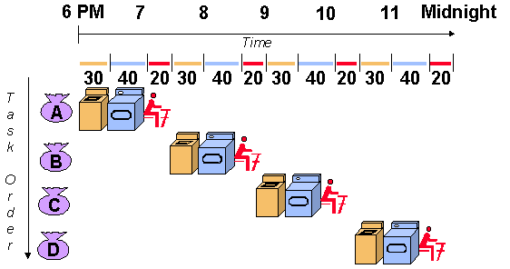
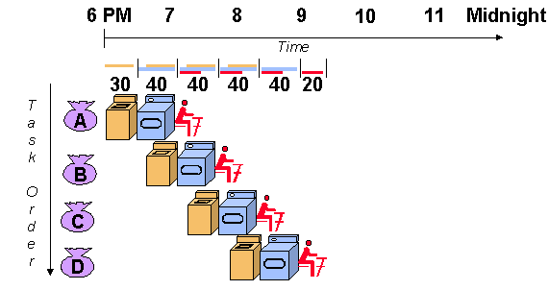
Pipelining
Technique where multiple instructions are overlapped in execution
Each stage completes a part of the execution in parallel
Pipelining does not decrease/increase the amount of time taken for any single instruction to execute
Pipelining increases throughput, i.e., number of instructions exiting the pipeline in unit time
Source: http://cse.stanford.edu/class/sophomore-college/projects-00/risc/pipelining/

Slide 15
Pipelining Stages
Processors can vary in the number of pipeline stages
Often some combination or extension of the following steps
Fetch instructions from memory
Decode the instruction
Execute the instruction or calculate an address
Access an operand in data memory
Write the result into a register

Slide 16
Issues in Pipelining
Length of the pipeline depends on the length of the longest step
Pipeline rate limited by slowest pipeline stage
Because RISC instructions are simpler than CISC, they lend themselves better to pipelining
RISC instructions are often the same length and can be fetched in one operation (ideally in 1 clock cycle)
OK, nothing is ever that simple or ideal
Data dependencies: Instruction depends on the output value of a previous instruction; value might not yet be ready because that previous instruction is also somewhere (although ahead of the current one) in the pipeline
Branch instructions: Next instruction to be executed is decided based on the result of executing another instruction; branch can be conditional on an instruction that has not even made it through the pipeline as yet
Pipeline is stalled; empty instructions (bubbles) inserted into the pipeline

Slide 17
Traditional ARM Pipeline
ARM traditionally employed a 3-stage pipeline with the following stages
Fetch: instruction fetched from memory
Decode: instruction is decoded
Execute: instruction is executed
When processor is executing simple data processing instructions the pipeline enables one instruction to be completed every clock cycle
1
fetch decode execute
2
fetch decode execute
3
fetch decode execute
time

Slide 18
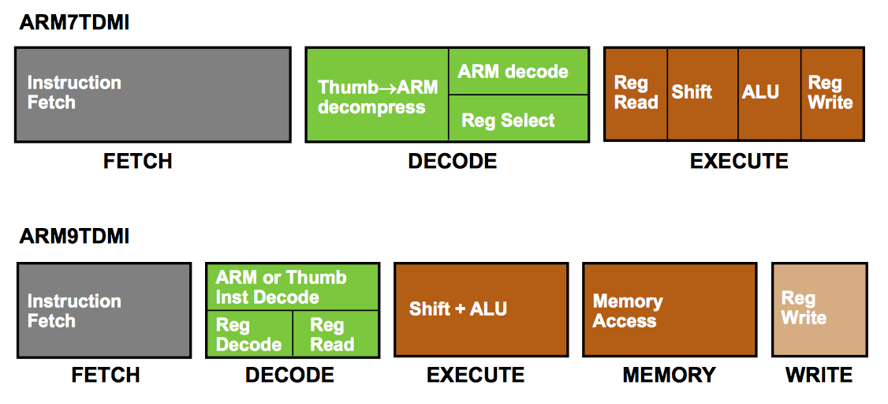
Pipeline Changes for ARM9TDMI

Slide 19
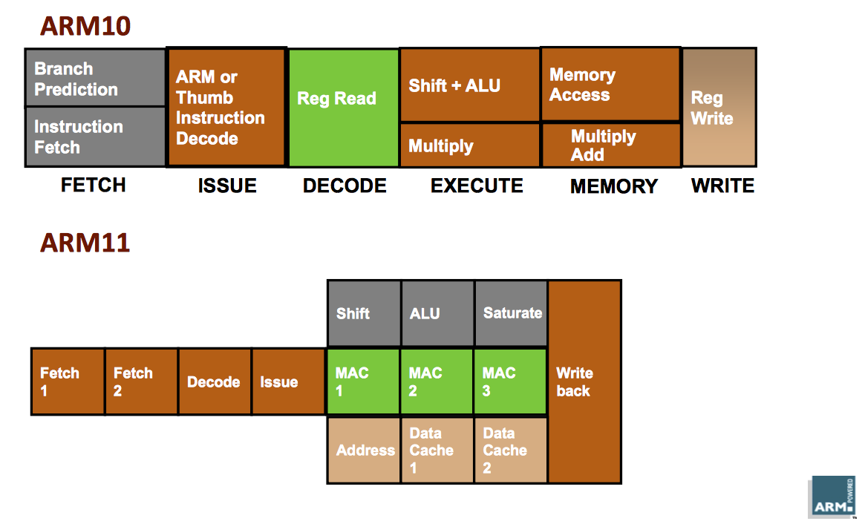
Pipeline changes for ARM10/11

Slide 20
The ARM Assembly Language
ARM instructions can be broadly classified as
Data Processing Instructions: manipulate data within the registers
Branch Instructions: changes the flow of instructions or call a subroutine
Load-Store Instructions: transfer data between registers and memory
Software Interrupt Instruction: causes a software interrupt
Program Status Instructions: read/write the processor status registers
All instructions can access r0-r14 directly
Most instructions also allow use of the pc
Specific instructions to allow access to cpsr and spsr

Slide 21
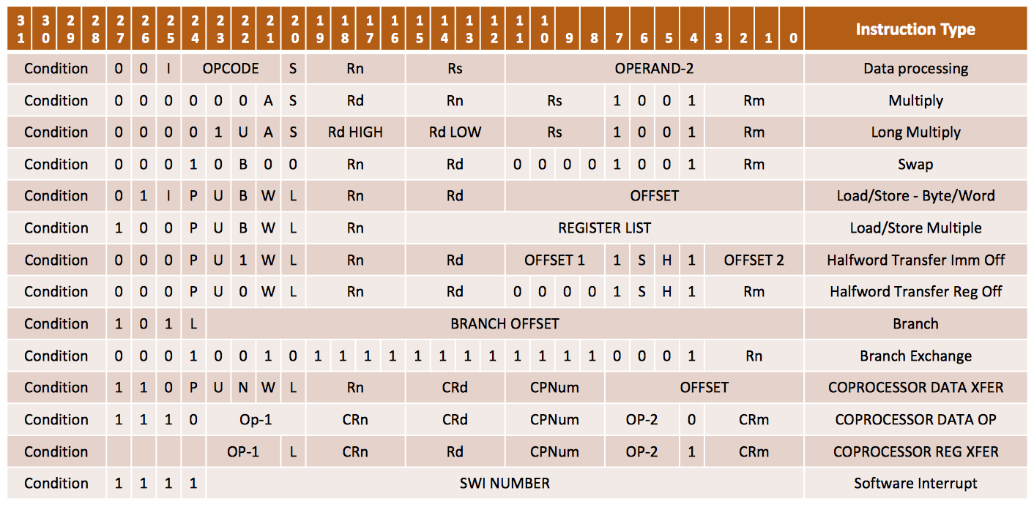
ARM Instruction Set Format

Slide 22
Data Processing Instructions
Manipulate data within registers
Move operations
Arithmetic operations
Logical operations
Comparison operations
Multiply operations
Appending the S suffix for an instruction, e.g, ADDS
Signifies that the instruction’s execution will update the flags in the cpsr

Slide 23
Typical Data Processing Instruction
<Operation>
<Cond>
{S}
Rd
Rn
ShifterOperand2
Operation – Specifies the instruction to be performed
Cond – specify the optional conditional flags which have to be set under which to execute the instruction
Almost all ARM instructions can be conditionally executed
S bit – Signifies that the instruction updates the conditional flags
Rd – Specifies the destination register
Rn – Specifies the first source operand register
ShifterOperand2 – Specifies the second source operand
Could be a register, immediate value, or a shifted register/immediate value
Some data processing instructions may not specify the destination register or the source register

Slide 24
Data Processing Instructions
Consist of :
Arithmetic: ADD ADC SUB SBC RSB RSC
Logical: AND ORR EOR BIC
Comparisons: CMP CMN TST TEQ
Data movement: MOV MVN
These instructions only work on registers, NOT memory

Slide 25
Move Instruction
MOV moves a 32-bit value into a register
MVN moves the NOT of the 32-bit value into a register
PRE
r5 = 5
r7 = 8
MOV r7, r5
POST
r5 = 5
r7 = 5
Notes:
R5 = r7 = 5

Slide 26
The ARM Barrel Shifter
Data processing instructions are processed within the ALU
ARM can shift the 32-bit binary pattern in one of the source registers left or right by a specific number of positions before the value enters the ALU
Can achieve fast multiplies or division by a power of 2
Data-processing instructions that do not use the barrel shifter
MUL (multiply)
CLZ (count leading zeros)
QADD (signed saturated 32-bit add)
Rn
Rm
No pre-processing
Pre-processing
Result N
Arithmetic and Logic
Unit (ALU)
Rd

Slide 27
Using the Barrel Shifter
LSL shifts bits to the left, and is similar to the C-language operator <<
PRE
r5 = 5
r7 = 8
MOV r7, r5, LSL #2
POST
r5 = 5
r7 = 20
r7 = r5 * 4 = (r5 << 2)

Slide 28
Updating the Condition Flags
The S suffix indicates that the cpsr should be updated
PRE cpsr = nzcvqiFt_USER
r0 = 0x00000000
r1 = 0x80000004
MOVS r0, r1, LSL #1
POST cpsr = nzCvqiFt_USER
r0 = 0x00000008
r1 = 0x80000004
Hint: 32-bit version of 0x80000004 is
1000 0000 0000 0000 0000 0000 0000 0100
Notes:
r0 = 0x00000008, r1 = 0x80000004, cpsr has C flag also set
V flag does not get set since the specs for MOV instruction only allow C and Z flags to be affected
Assume 3 bit numbers
Carry but no overflow when you do -2 (110)+-2(110) = -4 ( 1100)
Overflow but no carry when you do 2 (010) + 2 (010) = -4 (100)
If the problem is changed to MOVS r0, r1, LSL #2 then no Carry is generated. Think of Carry bit in an operation MOV Rd, Rm, ShiftValue as Rm[32-ShiftValue] as long as ShiftValue > 0 (otherwise Carry bit is the same as what it was before).

Slide 29
Arithmetic Operations
Operations are:
ADD operand1 + operand2 ; Add
ADC operand1 + operand2 + carry ; Add with carry
SUB operand1 ‐ operand2 ; Subtract
SBC operand1 ‐ operand2 + carry ‐1 ; Subtract with carry
RSB operand2 ‐ operand1 ; Reverse subtract
RSC operand2 ‐ operand1 + carry ‐ 1 ; Revers sub with carry
Syntax:
<Operation>{<cond>}{S} Rd, Rn, Operand2
Examples
ADD r0, r1, r2
SUBGT r3, r3, #1
RSBLES r4, r5, #5
Notes:
{S} for updating condition flags

Slide 30
Arithmetic Instructions
Subtract
PRE r0 = 0x00000000
r1 = 0x00000002
r2 = 0x00000001
SUB r0, r1, r2
POST r0 = 0x00000001
r1 = 0x00000002
r2 = 0x00000001
Addition
PRE r0 = 0x00000000
r1 = 0x00000005
ADD r0, r1, r1, LSL #1
POST r0 = 0x0000000f
r1 = 0x00000005
Notes:
Part 1: r0 = 0x00000001, r1 and r2 unchanged
Part 2: Write r1 as 0000 0000 0000 0000 0000 0000 0000 0101
This value left-shifted by 1 is 0000 0000 0000 0000 0000 0000 0000 1010 = 0xoa
Add r1 back to this: r1 + left-shifted r1 = 0x05 + 0x0a = 0x0f
Final: r0 = 0x0000000f, r1 = 0x00000005

Slide 31
Logical Operations
Operations are:
AND operand1 AND operand2 ; and
EOR operand1 EOR operand2 ; xor
ORR operand1 OR operand2 ; or
ORN operand1 NOR operand2 ; or negative (nor)
BIC operand1 AND NOT operand2 ; bit clear
Syntax:
<Operation>{<cond>}{S} Rd, Rn, Operand2
Examples
AND r0, r1, r2
BICEQ r2,r3 #7
EORS r1,r3,r0
Notes:
{S} for updating condition flags

Slide 32
Logical Instructions
Every binary 1 in r2 clears a corresponding bit location in r1
Bitwise logical operations on two source registers
AND, ORR, EOR, BIC
Logical OR
PRE r0 = 0x00000000
r1 = 0x02040608
r2 = 0x10305070
ORR r0, r1, r2
POST r0 = 0x12345678
r1 = 0x02040608
r2 = 0x10305070
Logical bit clear (BIC)
PRE r1 = 0b1111
r2 = 0b0101
BIC r0, r1, r2
POST r0 = 0b1010
r1 = 0b0101
r2 = 0b0101
Notes:
BIC = Bit Clear

Slide 33
Multiply Instructions
Multiple a pair of registers and optionally add (accumulate) the value stored in another register
MUL Rd, Rm, Rs Rd = Rm*Rs
MLA Rd, Rm, Rs, Rn Rd = Rm*Rs + Rn
Special instructions called long multiplies accumulate onto a pair of registers representing a 64-bit value
SMLAL, SMULL, UMLAL, UMUL
PRE r0 = 0x00000000 MUL r0, r1, r2 POST r0 = 0x04
r1 = 0x00000002 r1 = 0x02
r2 = 0x00000002 r2 = 0x02

Slide 34
Conditional Execution
Most instruction sets only allow branches to be executed conditionally
However ARM reuses the condition evaluation hardware to effectively increase number of instructions
All instructions have a field to determine if they should be conditionally executed
Non-executed instructions consume 1 cycle
This removes many of the needs for branches, which stall the pipeline (at least 3 refill cycles)

Slide 35
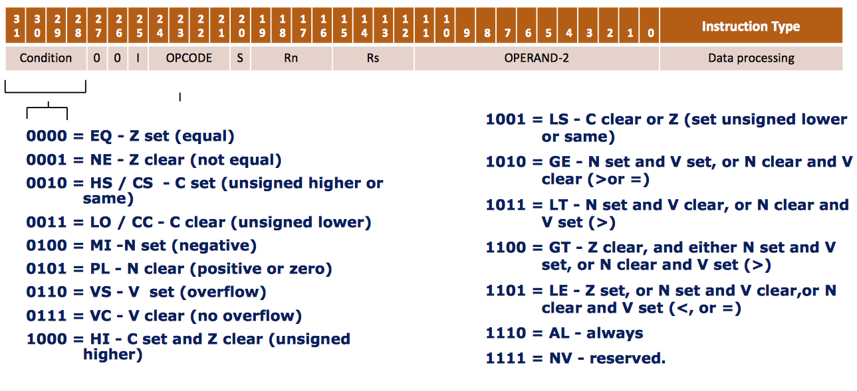
The Condition Field

Slide 36
Conditional Mnemonics
Suffix/Mnemonic
Description
Flags tested
EQ
Equal
Z=1
NE
Not equal
Z=0
CS/HS
Unsigned higher or same
C=1
CC/LO
Unsigned lower
C=0
MI
Minus
N=1
PL
Positive or Zero
N=0
VS
Overflow
V=1
VC
No overflow
V=0
HI
Unsigned higher
C=1 & Z=0
LS
Unsigned lower or same
C=0 or Z=1
GE
Greater or equal
N=V
LT
Less than
N!=V
GT
Greater than
Z=0 & N=V
LE
Less than or equal
Z=1 or N=!V
AL
Always

Slide 37
Comparison Instructions
The only effect of comparison is to update the condition flag. So now “S bit” needed.
Operations are:
CMP operand1 - operand2 ; Compare
CMN operand1 + operand2 ; Compare Negative
TST operand1 ANDoperand2 ; Test
TEQ operand1 EOR operand2 ; Test equivalence
Syntax:
<Operation>{<cond>} Rn, Operand2
Examples
CMP r0, r1
TSTEQ r2, #5

Slide 38
Comparison Instructions
Compare or test a register with a 32-bit value
CMN, CMP, TEQ, TST;
Outcome: Registers under comparison are not affected; cpsr updated
Example: CMP x,y sets cpsr flags based on results of x-y (subtract)
Example: TST x,y sets cpsr flags based on results of x&y (logical AND)
Do not need the S suffix
PRE cpsr = nzcvqiFt_USER
r0 = 4
r9 = 4
CMP r0, r9
POST cpsr = nZcvqiFt_USER
r0 = 4
r9 = 4
Notes:
Cpsr nZcvqiFt_USER
Template: Instruction Rn, N
CMN – flags set based on Rn + N
CMP – flags set based on Rn – N
TEQ – flags set based on Rn ^ N (logical XOR)
TST – flags set based on Rn & N

Slide 39
Branch Instructions
To change the flow of execution or to call a routine
Supports subroutine calls, if-then-else structures, loops
Change of execution forces the pc to point to a new address
Four different branch instructions on the ARM
B{<cond>} label
BL{<cond>} label
BX{<cond>} Rm
BLX{<cond>} label | Rm
Notes:
B = branch
BL = branch with link (Add PC+4 to R14)
BX = Branch exchange (Branch back from R14)
BLX = branch exchange with link

Slide 40
Value of Conditional
This improves code density and performance by reducing the number of forward branch instructions
if (x != 0) CMP r3,#0 a = b+c; BEQ skip else ADD r0,r1,r2
a = b–c; B afterskip
skip
SUB r0, r1, r2
afterskip
CMP r3,#0 ADDNE r0,r1,r2
SUBEQ r0,r1,r2

Slide 41
Examples of Conditional Execution
Use a sequence of several conditional instructions
if (a==0) x=1;
CMP r0,#0 MOVEQ r1,#1
Set the flags, then use various condition codes
if (a==0) x=0; if (a>0) x=1;
CMP r0,#0 MOVEQ r1,#0 MOVGT r1,#1
Use conditional compare instructions
if (a==4 || a==10) x=0;
CMP r0,#4 CMPNE r0,#10 MOVEQ r1,#0

Slide 42
Single Register Data Transfer
ARM is based on a “load/store” architecture
All operands should be in registers
Load instructions are used to move data from memory into registers
Store instructions are used to move data from registers to memory
Flexible – allow transfer of a word or a half-word or a byte to and from memory
LDR/STR Word
LDRB/STRB Byte
LDRH/STRH Halfword
LDRSB Signed byte load
LDRSH Signed halfword load
Syntax:
LDR{<cond>}{<size>} Rd, <address>
STR{<cond>}{<size>} Rd, <address

Slide 43
LDR and STR
LDR and STR instructions can load and store data on a boundary alignment that is the same as the datatype size being loaded or stored
LDR can only load 32-bit words on a memory address that is a multiple of 4 bytes – 0, 4, 8, and so on
LDR r0, [r1]
Loads register r0 with the contents of the memory address pointed to by register r1
STR r0, [r1]
Stores the contents of register r0 to the memory address pointed to by register r1
Register r1 is called the base address register

Slide 44
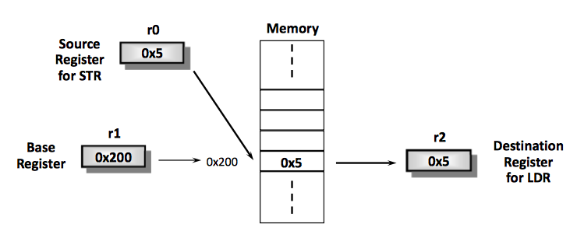
LDR/STR Example
The memory location to be accessed is held in a base register
STR r0, [r1] ; Store contents of r0 to location pointed
; to by contents of r1.
LDR r2, [r1] ; Load r2 with contents of memory location
; pointed to by contents of r1

Slide 45
Addressing Modes (1-4)
ARM provides three addressing modes
Preindex with writeback
Preindex
Postindex
Preindex mode useful for accessing a single element in a data structure
Postindex and preindex with writeback useful for traversing an array

Slide 46
Addressing Modes (2-4)
Preindex
Same as preindex with writeback, but does not update the base register
Example: LDR r0, [r1, #4]
Preindex with writeback
Calculates address from a base register plus address offset
Updates the address in the base register with the new address
The updated base register value is the address used to access memory
Example: LDR r0, [r1, #4]!
Postindex
Only updates the base register after the address is used
Example: LDR r0, [r1], #4

Slide 47
Addressing Modes (3-4)
PRE r0 = 0x00000000
r1 = 0x00009000
mem32[0x00009000] = 0x01010101
mem32[0x00009004] = 0x02020202
Preindexing with writeback
LDR r0, [r1, #4]!
POST r0 =
r1 =
Preindexing
LDR r0, [r1, #4]
POST r0 =
r1 =
Postindexing
LDR r0, [r1], #4
POST r0 =
r1 =
0x02020202
0x00009004
0x02020202
0x00009000
0x01010101
0x00009004

Slide 48
Addressing Modes (4-4)
Address <address> accessed by LDR/STR is specified by
A base register plus an offset
Offset takes one of the three formats
Immediate: offset is a number that can be added to or subtracted from the base register
Example: LDR r0,[r1, #8]; r0 b mem[r1+8]
LDR r0,[r1, #-8]; r0 b mem[r1-8]
Register: offset is a general-purpose register that can be added to or subtracted from the base register
Example: LDR r0,[r1, r2]; r0 b mem[r1+r2]
LDR r0,[r1, -r2]; r0 b mem[r1-r2]
Scaled Register: offset is a general-purpose register shifted by an immediate value and then added to or subtracted from the base register
Example: LDR r0,[r1,r2, LSL #2]; r0 b mem[r1+4*r2]

Slide 49
Summary
Exceptions
Vector Table
Pipelining
What is it?
Why do we do it?
ARM ISA Introduction
Next Lecture
Addressing Modes (reviewed) and Block Data Transfer
Stack
Memory Mapped IO

